Slide 1

Group-5 Final Presentation
Presentation made by
Parva Shah (ps7384)
Purvi Lalan (pl1223)
Rutvi Kathiriya (rk4739)
Sakshi Jadhav (sj9017)

Slide 2

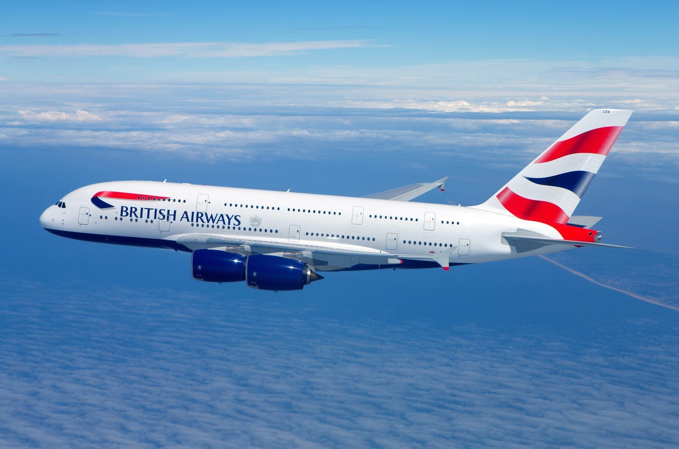
Visualizing British Airways Customer Reviews

Slide 3

INTRODUCTION
The comprehensive datasets that we have been using for our research contain information on all the reviews of British Airways from March 2016 to October 2023, and now we are set to discover some critical ideas with their help. It will enable us to understand those who are most satisfied with BA services and what aspects of these offerings resonate the best among various segments such as business travelers, leisure travelers, families or solo travelers.
This analysis seeks to identify strengths and areas for improvement in the airline’s services, as well as determine which target audience would be most responsive towards future marketing initiatives. The insights provided by our data can give answers to these important questions; hence improve customer experience in BA through improved service delivery thus enhancing its reputation.

Slide 4
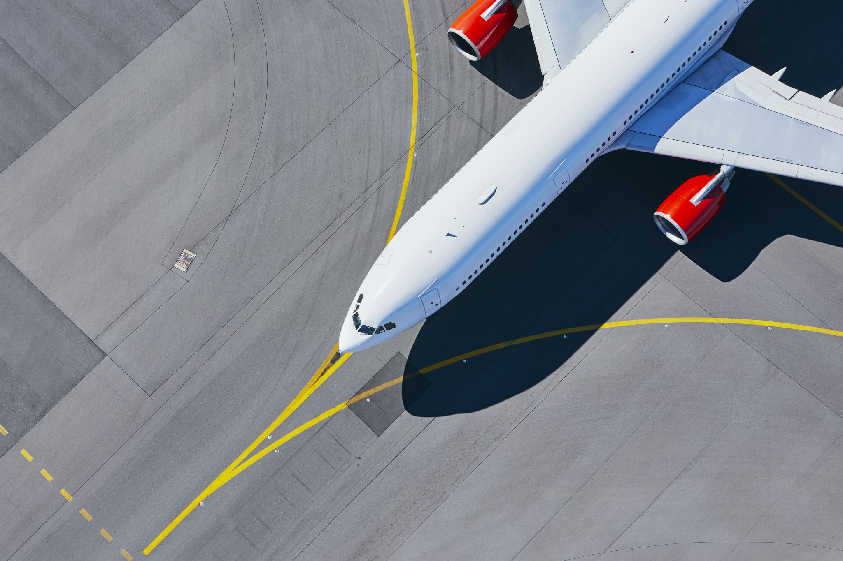
OBJECTIVE
The project focuses on detailed analysis and visualization of feedback from customers about British Airways’ service delivery. With painstaking data collection and disaggregation across various categories such as food, entertainment, seat comfort, staff service, aircraft type and geographical region – this project will show how these various aspects have fared over time. Additionally, data has been organized by month so that one can analyze trends and seasonal changes in customer satisfaction. This kind of thorough dissection helps identify where the airline does well or not well enough thus giving a precise direction for targeted improvement efforts.
This project ultimately aims at establishing a feedback loop for continuous improvement within British Airways. The airline can then be able to make informed decisions that improve quality of its services through integrating customer feedback into strategic planning systems. As a result, this is also expected to increase customer satisfaction leading to more loyal passengers which is desired by airlines globally Visuals serve as a way not only for internal evaluation but also transparent communication with customers on how their opinion was used in order to implement visible improvements. Such proactive approach toward customer support aims at creating a virtuous cycle whereby better services result in more satisfaction and increased client retention.

Slide 5
IMPACT
The project gives insights on how British Airways customers perceive their service thus its perception to passengers. This data is vital for:
1. Identifying Trends: Observing the changes in ratings with time will enable us to know whether customer response to any changes in the service or operations is positive or negative.
2. Customizing Service: Services can be provided that are closer to expectations by understanding preferences on different routes, in different classes, or by different types of travelers.
3. Operational Focus: Resources can be directed towards areas where lower ratings are given (e.g., entertainment, seat comfort) to facilitate improvements.
4. Strategic Planning:
Long-term strategies can be developed based on which aspects of the service consistently receive higher or lower ratings
5. Reputation Management: Marketing strategies may benefit from high scores in some dimensions, while low scores could indicate areas that must be addressed in order not to risk damaging the airline’s reputation.

Slide 6
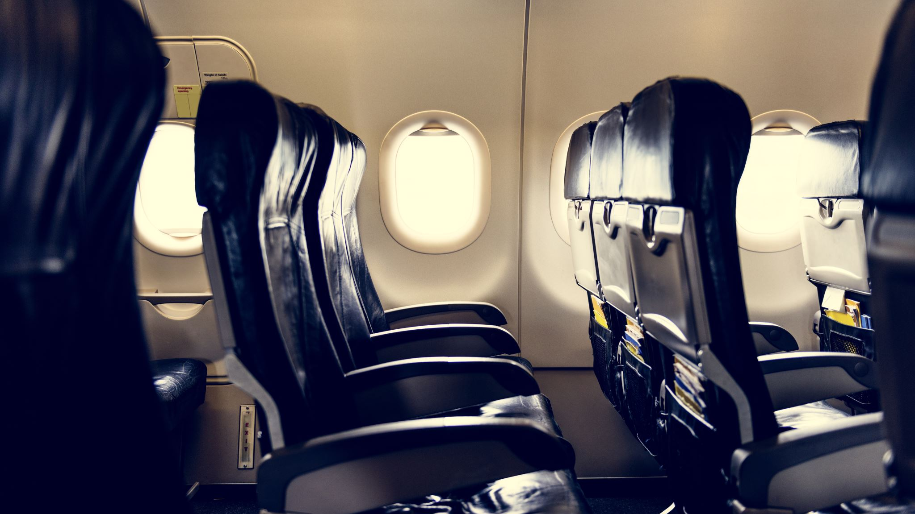
FINDING AND RESULTS

Slide 7
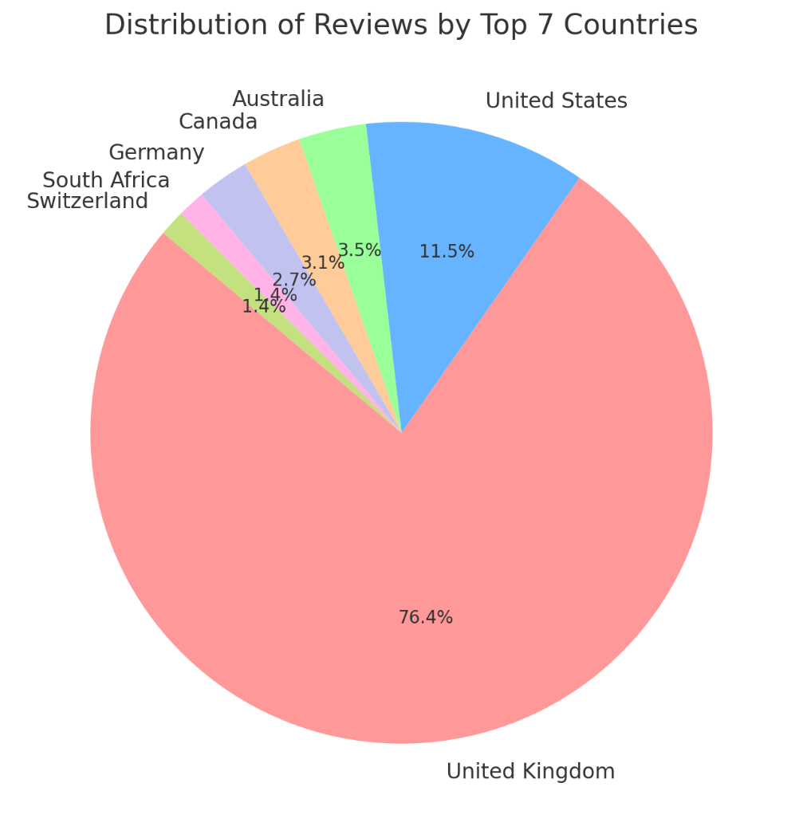
REVIEWS BY COUNTRIES
ACTION PLAN:
- Analyze UK feedback to improve services.
- Tailor offerings to meet US customer needs.
- Research markets with fewer reviews.
- Incentivize feedback from less-represented countries.
- Customize marketing strategies for different regions.
- Offer localized in-flight services.
- Enhance loyalty programs.
- Consider route expansion in underrepresented markets.
- Train staff in cultural sensitivity for diverse customer service.
- Boost online engagement through social media.
- Create local partnerships to increase brand presence.
The United Kingdom has majority of reviews while all other countries contribute much lesser percentages with United States being second largest contributor.

Slide 8
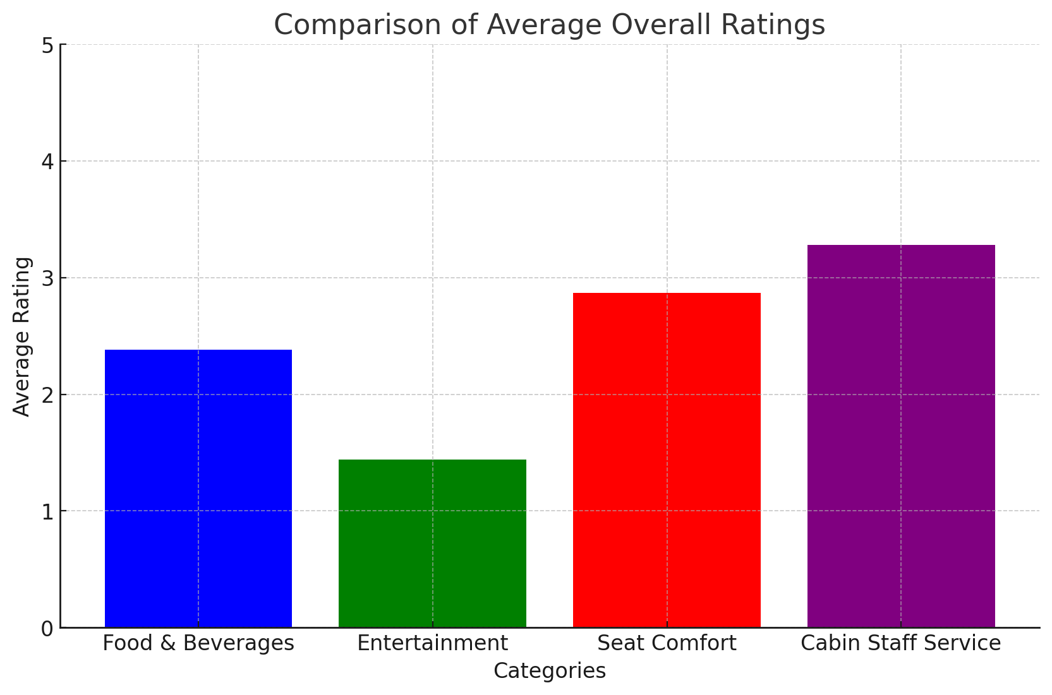
This is evidenced by Cabin Staff Service which gained highest average rating showing high satisfaction in this category while Entertainment had lowest average rating suggesting low satisfaction level.
OVERALL RATINGS
ACTIONS TO TAKE
Reward and learn from top-performing cabin crew.
Conduct a survey to know customer preferences and update the in-flight entertainment library with new movies, TV shows, games, music among other things.
Collaborate with chefs for more variety of food; offer pre-orders.
Enhance seat ergonomics; raise legroom.

Slide 9
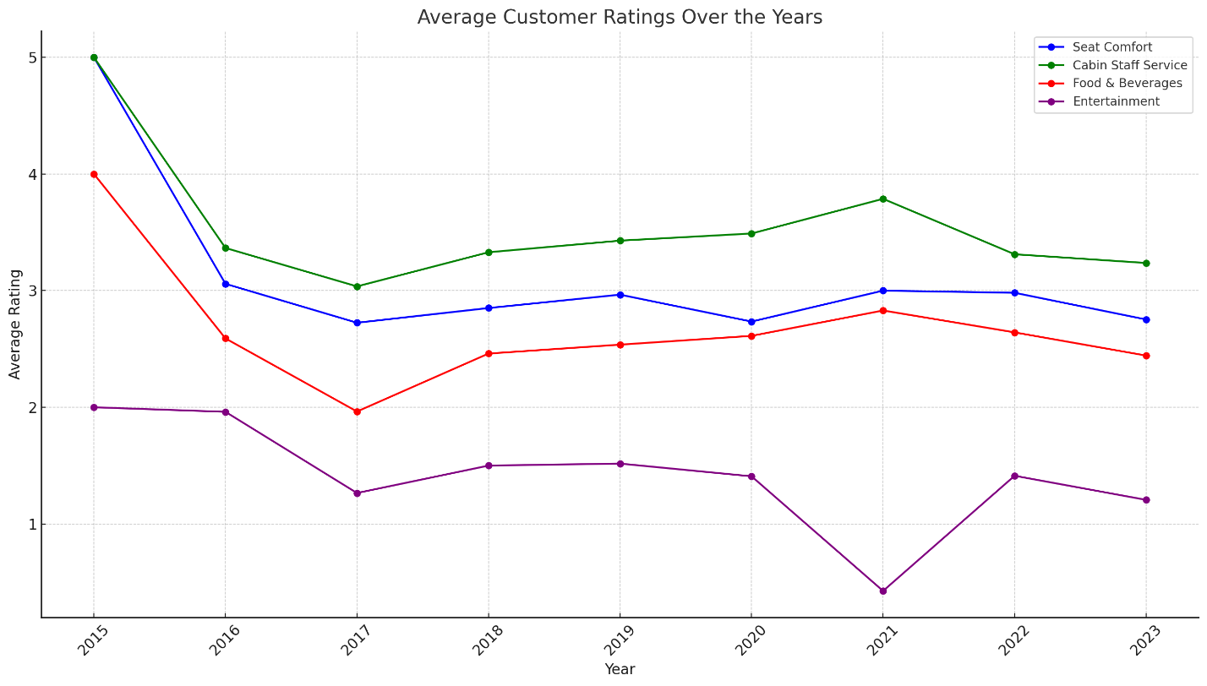
The figure implies that there was perhaps some initial decline in satisfaction at first followed by an overall trend or stability in customer ratings across most categories except a sharp decline in Entertainment shown in 2022.Thus Cabin Staff Service consistently receives highest ratings whereas Entertainment generally gets reported lowest.

Slide 10
Reasons
for Fluctuations
Economic Factors
Changes in economic conditions may affect the amount of money available for quality improvement or lead to budget cuts.
Service Changes
The introduction of new services or removal of existing ones may change customers’ satisfaction level.
Competitors Influence
Innovations by competitors can result in changes in consumer expectations.
Operational Challenges
Staff strikes, supply chain problems and fleet maintenance can lower service quality temporarily.
Market Trends
It is possible that changes in market trends or customer preferences could impact perceived quality.
External Events
Things like pandemics or geopolitical events could interfere with service delivery and alter customers' experiences.

Slide 11


Seat Comfort
Buy newer, more comfortable seats or refurbish old ones. Regularly check and keep seat mechanisms working properly.
Cabin Crew Service
Continuously train cabin crews while emphasizing good customer service. Develop reward programs that acknowledge excellent jobs done by workers.
Food & Beverages
Periodically review the menu incorporating suggestions made by travelers. Work with famous chefs/brands that have distinguished themselves as far as culinary artistry is concerned will improve the taste experience on board an aircraft
Entertainment
Install an updated flight entertainment system with broader selections and newer contents. Make sure it is user friendly as well as frequently serviced to avoid malfunctioning during journeys.
AREAS FOR Improvement

Slide 12
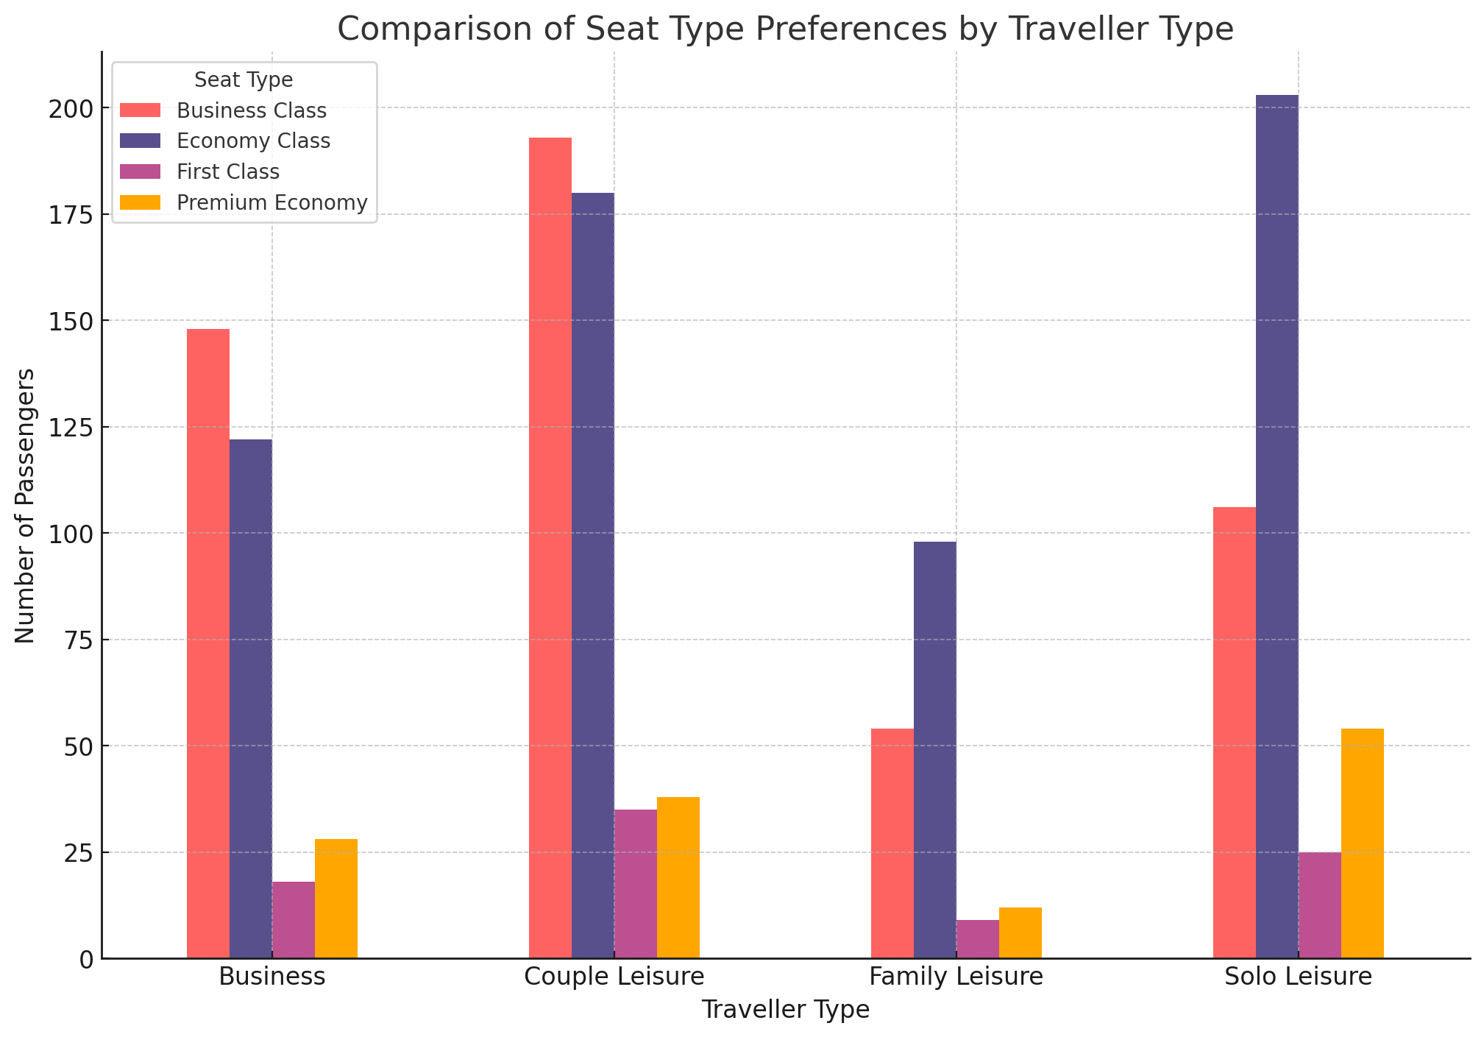
SWOT ANALYSIS FOR TRAVELLER TYPE: Strengths - Economy Class appeals across a broad spectrum. - Business Class is preferred by business travellers. Weaknesses - First Class does not have much appeal to many people. - Premium Economy does not fully serve the family and couple demographics. Opportunities - Target Premium Economy at families and couples. - An opportunity to upgrade solo travellers. Threats - Competitors can give better value. - Changes in economic conditions might push more people towards low-cost options. Actions - Review First Class offering. - Market the benefits of Premium Economy to target segments. - Personalized promotions for solo travelers. - Maintain high standards in Business Class.
The Economy Class appears to be the most preferred type of seat across all types of travelers, with particularly high numbers for Solo Leisure travelers. Couple travelers show a significant preference for Business Class. Premium Economy seems to be least preferred among Family Leisure travelers. First Class, while the least preferred overall, still has some representation among Couple Leisure and Solo Leisure travelers.

Slide 13
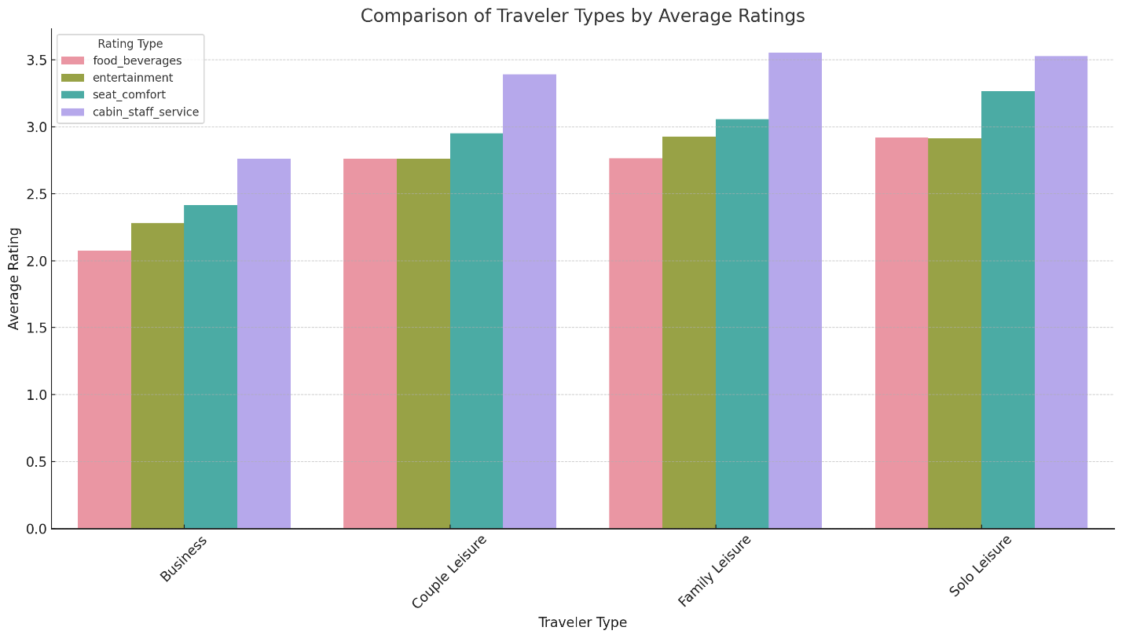
Across all groups, business travelers have given the lowest marks in every category as compared to leisure travelers who may have had higher expectations due to more travel. The most satisfied group is Solo leisure travelers; they rate all categories higher than other groups which indicates positive traveling experiences. Ratings by Couple Leisure are slightly better than that of Business but not as much as those by Solo Leisure while Family Leisure sees high scores for seat comfort and cabin staff service implying their great relevance to people that travel with relatives Overall however, although there are variance in level of satisfaction among others, it is seen that seat comfort and cabin crew services are highly appreciated by all customers regardless of whether one is travelling alone, with a partner or with family.

Slide 14
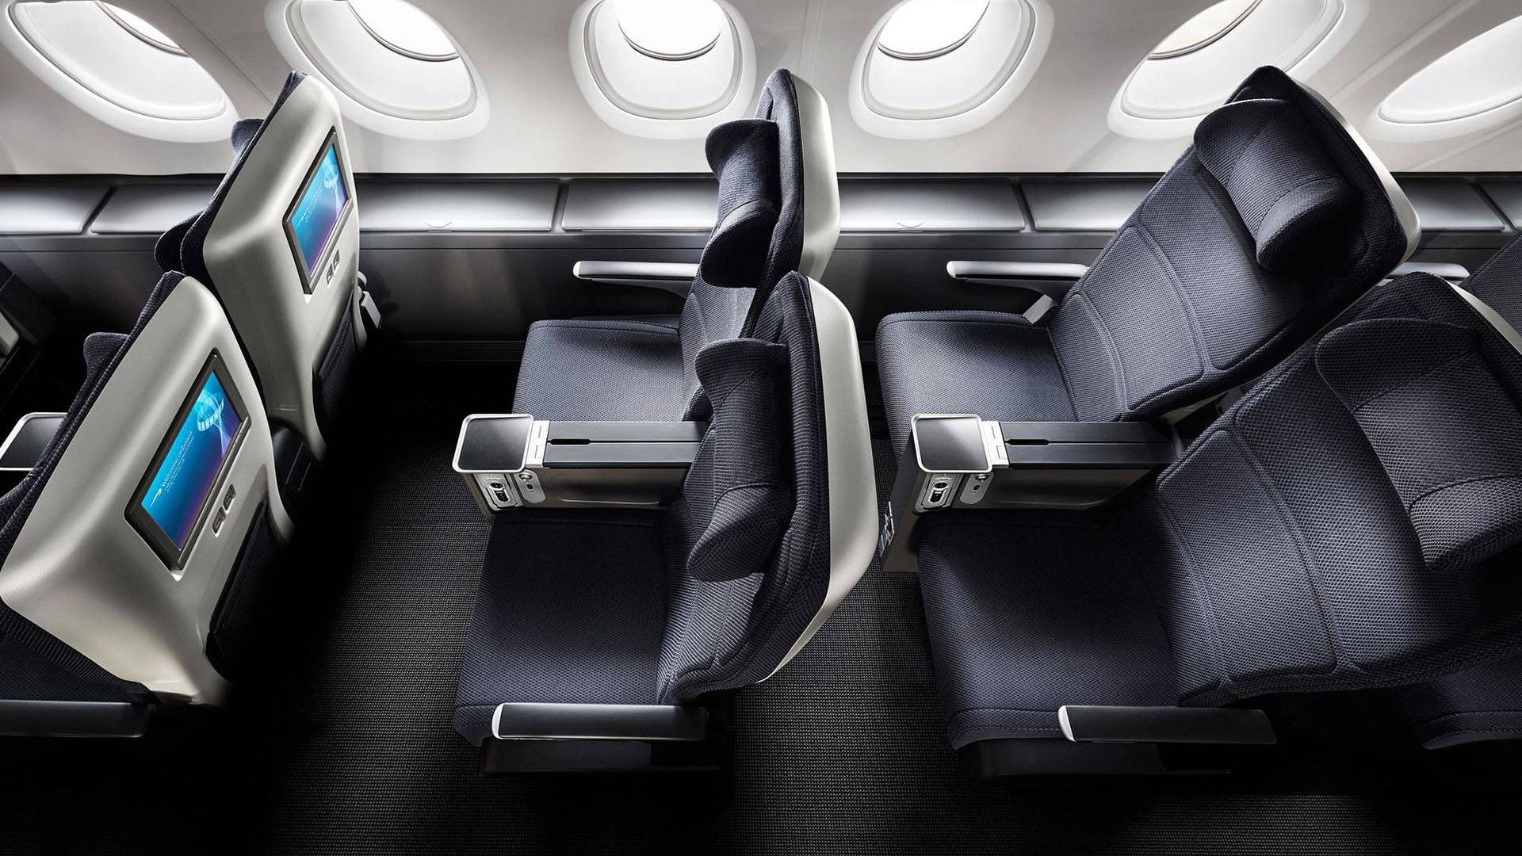
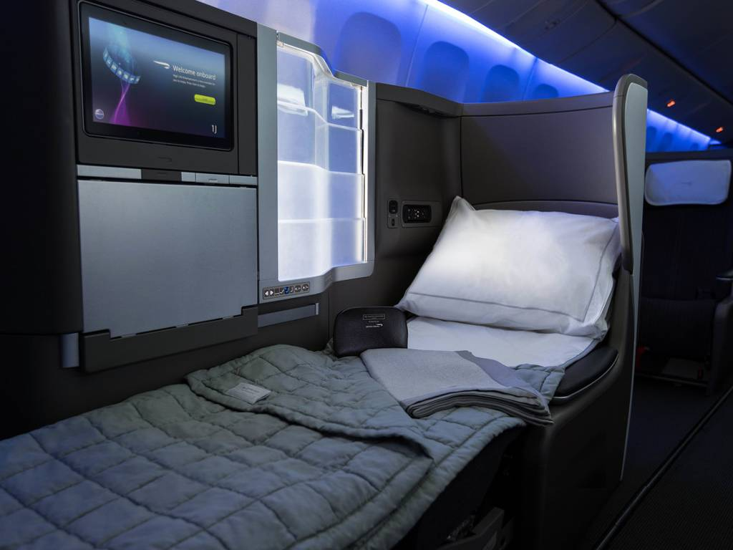
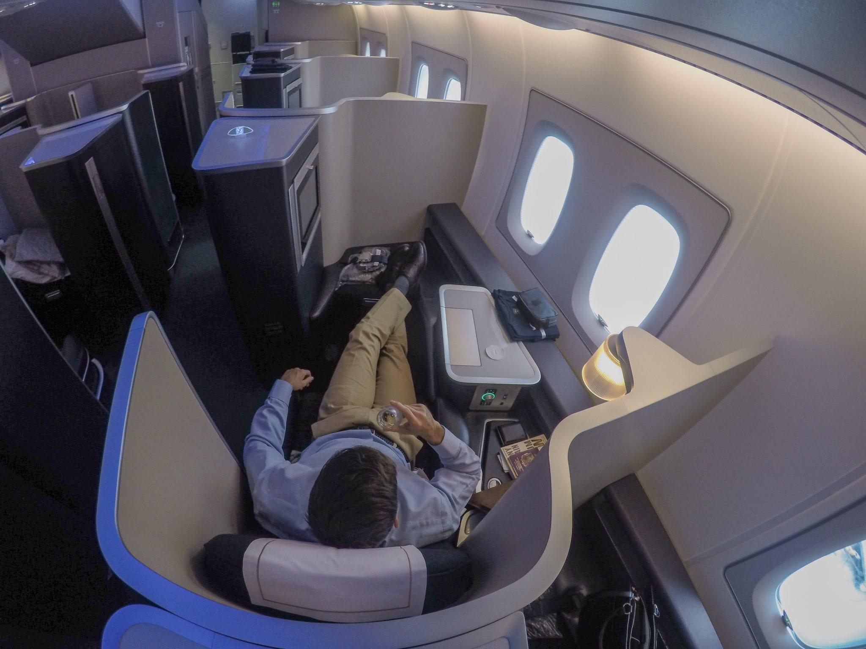
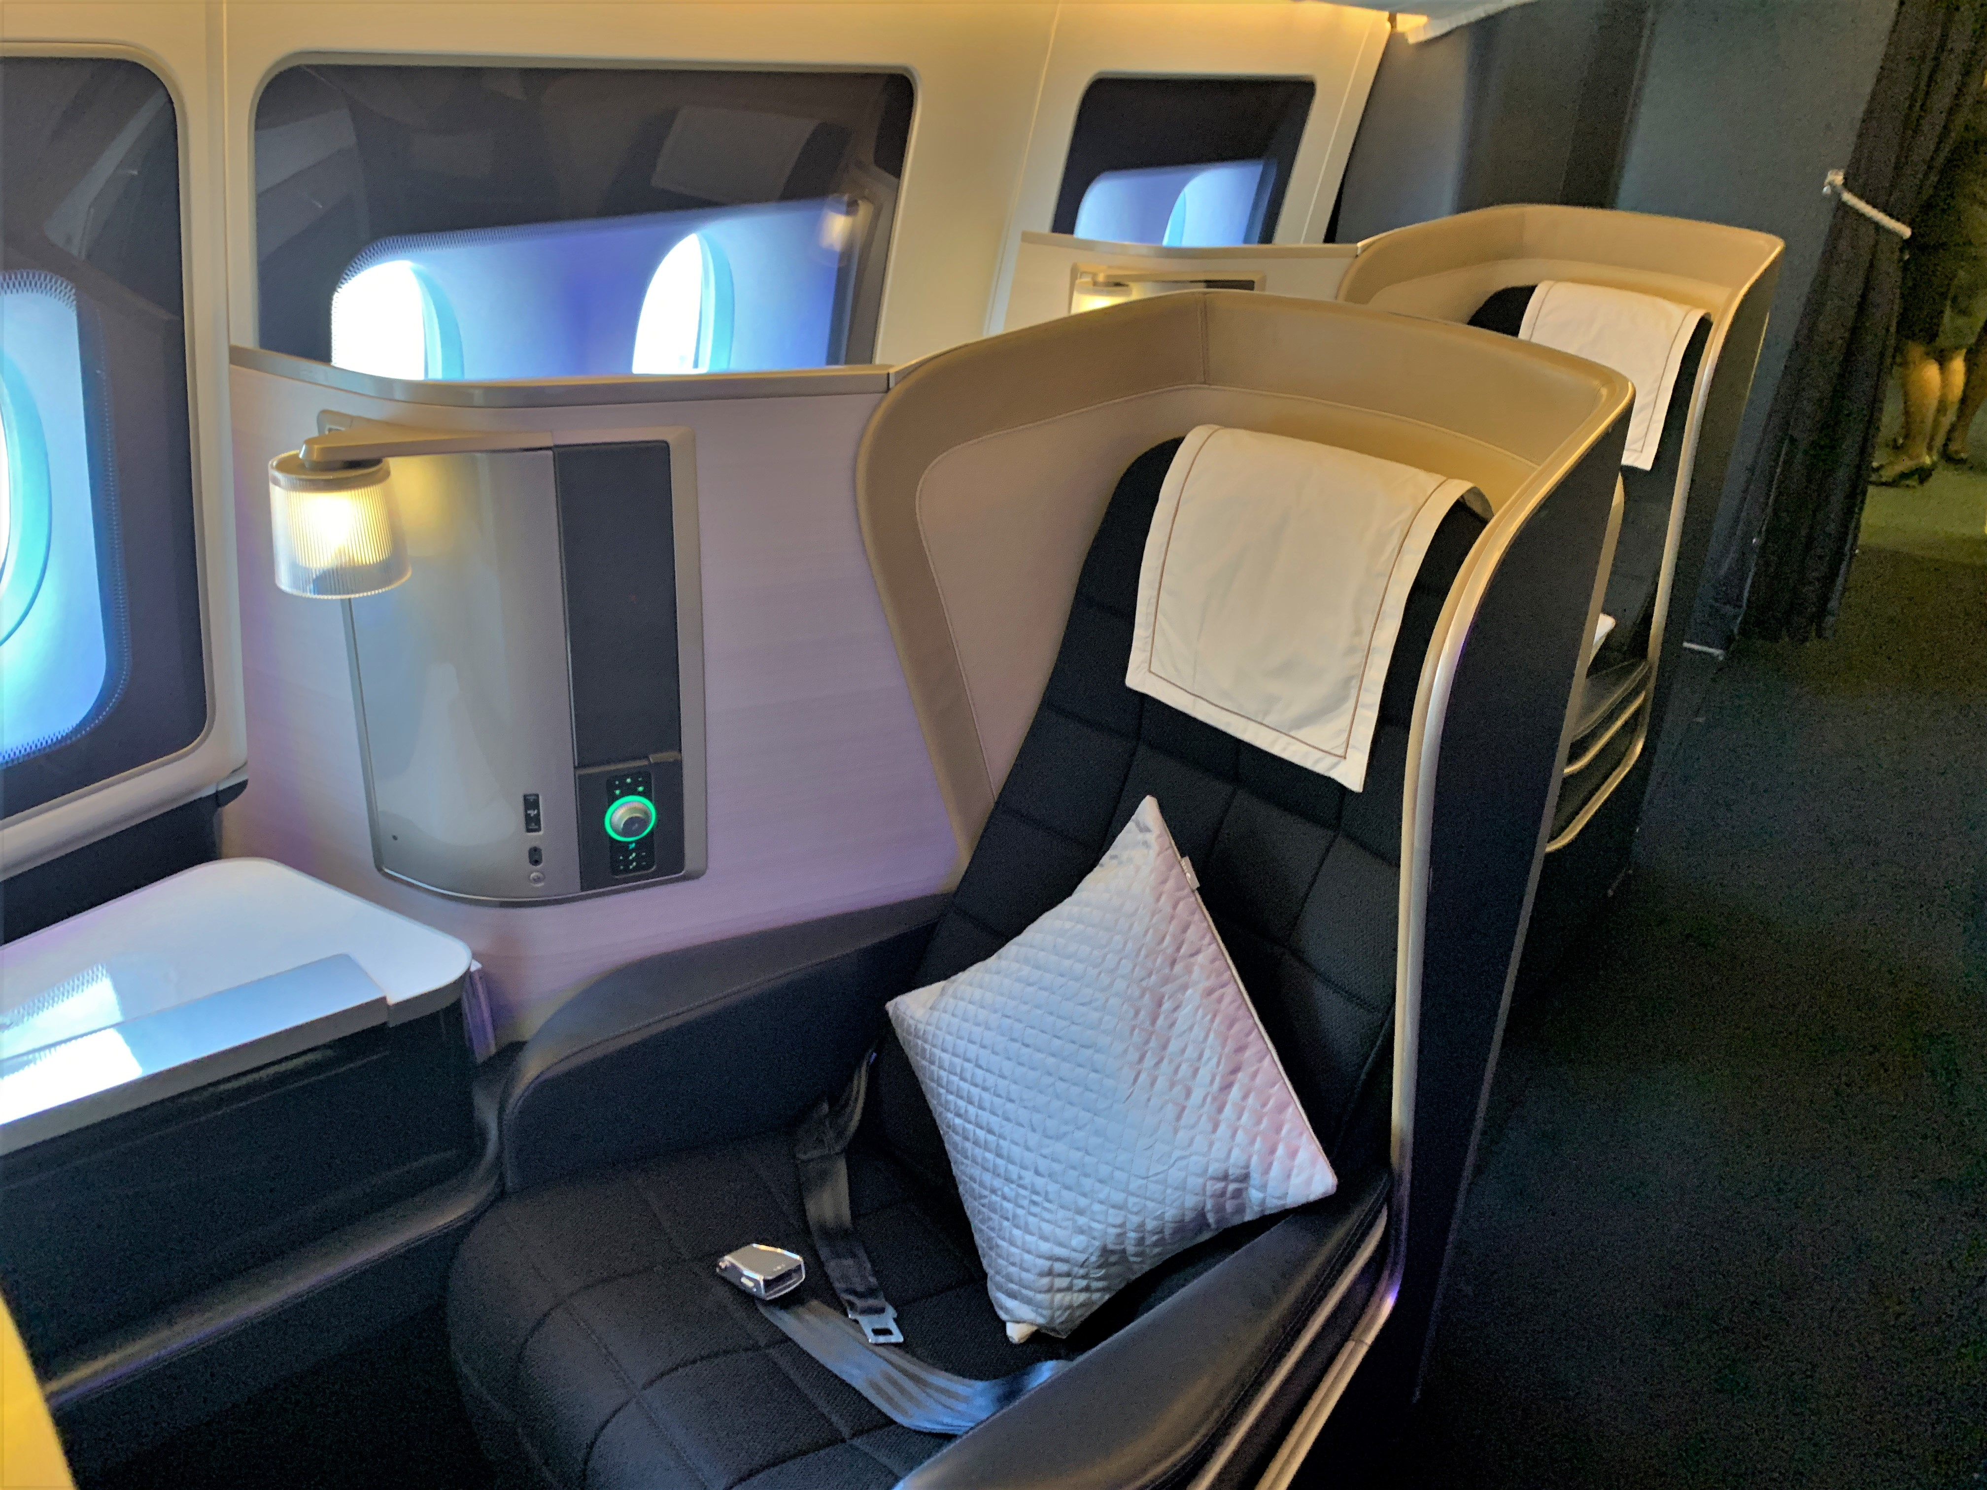
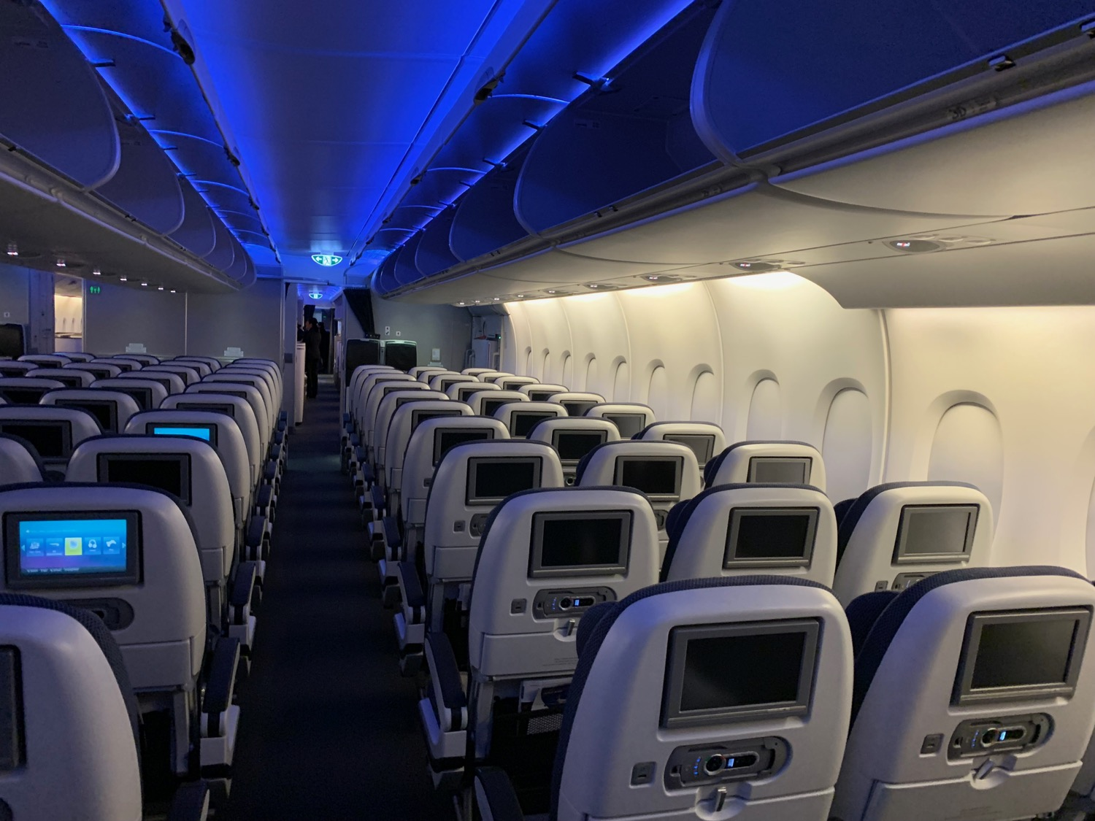
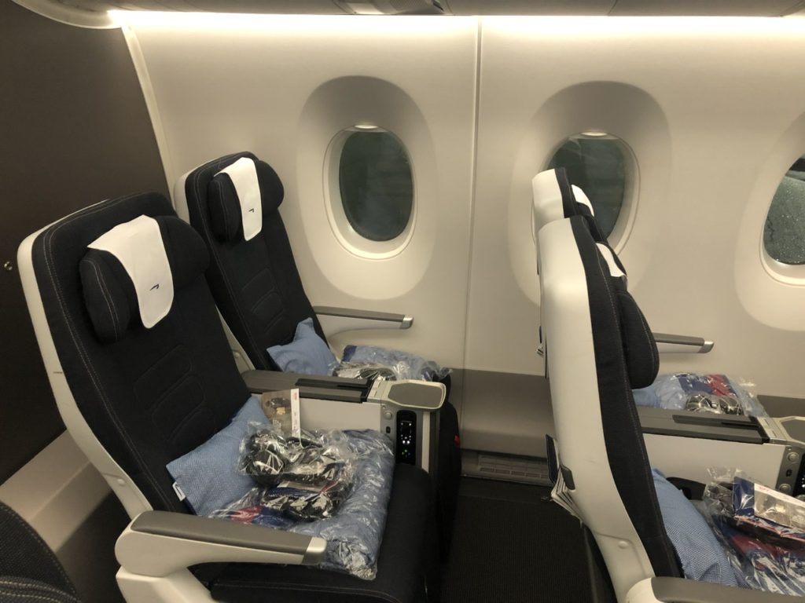
DIFFERENT TYPES OF SEAT
Premium Economy
Business Class
First Class
ECONOMY CLASS

Slide 15
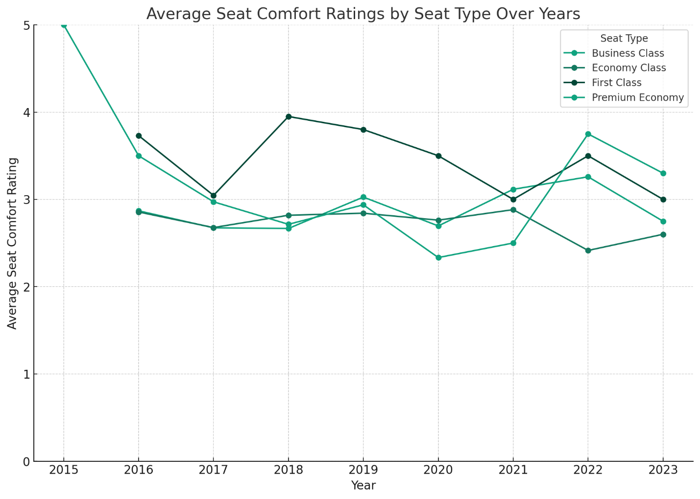
ANALYSIS BY SEAT TYPE OVER YEARS

Slide 16
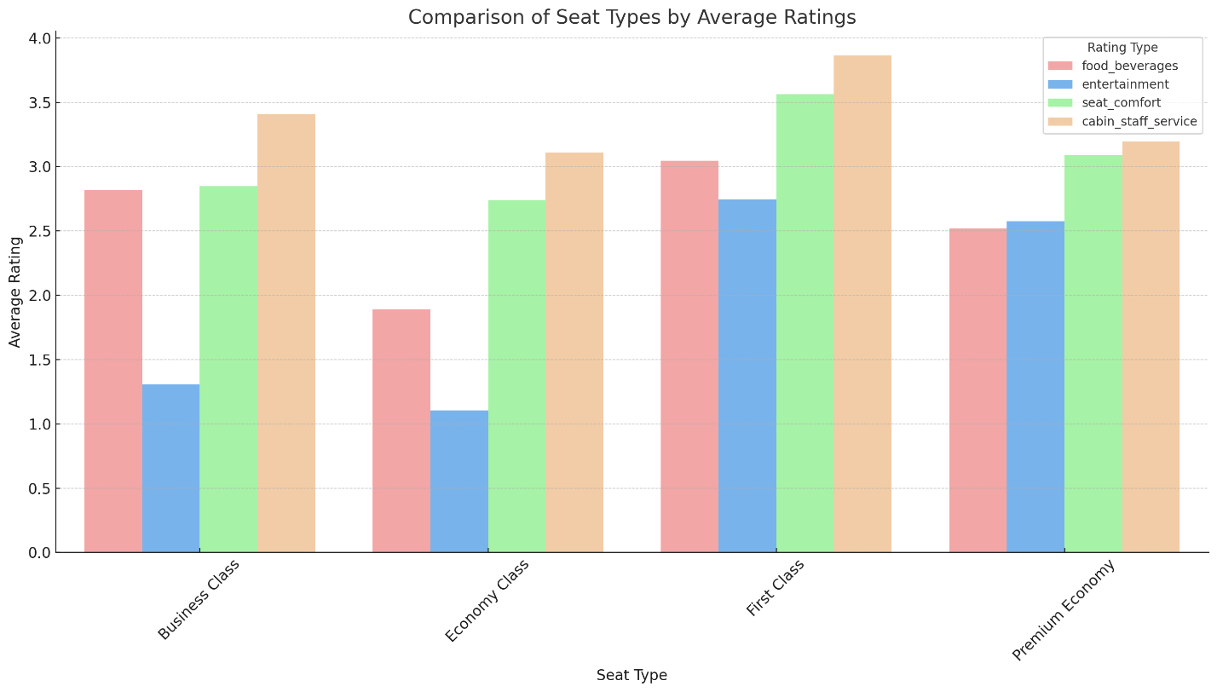
First Class has the highest rating in comfort, Cabin Staff Service is the best in Business Class, Economy class has the lowest ratings overall, and Premium Economy is average for all services.

Slide 17
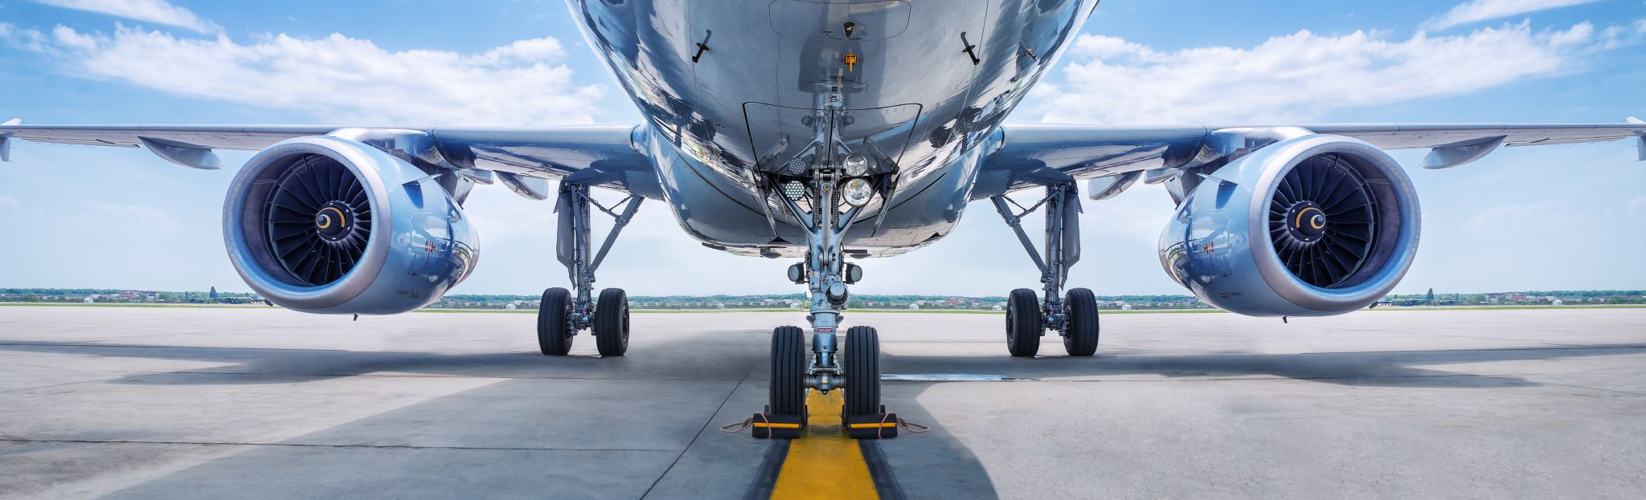
Weaknesses - Economy class has also been found to have the poorest rate in all services. - Food and Beverages have scored poorly in higher classes.
SWOT ANALYSIS FOR SEAT TYPE
Opportunities
- Better Food/Beverage for Business and First Class - Improve Entertainment for holistic experience
Strengths - First Class has the highest rating of comfort. - The cabin staff service is highly rated across all classes.
Threats - This may cause migration due to low ratings of Economy. - Close rivals may provide superior experiences at upper levels.
Actions
- Make Economy Class better so that it gets good ratings - Review and improve Food/Beverages in premium categories - Update Entertainment systems & content for all cabins

Slide 18
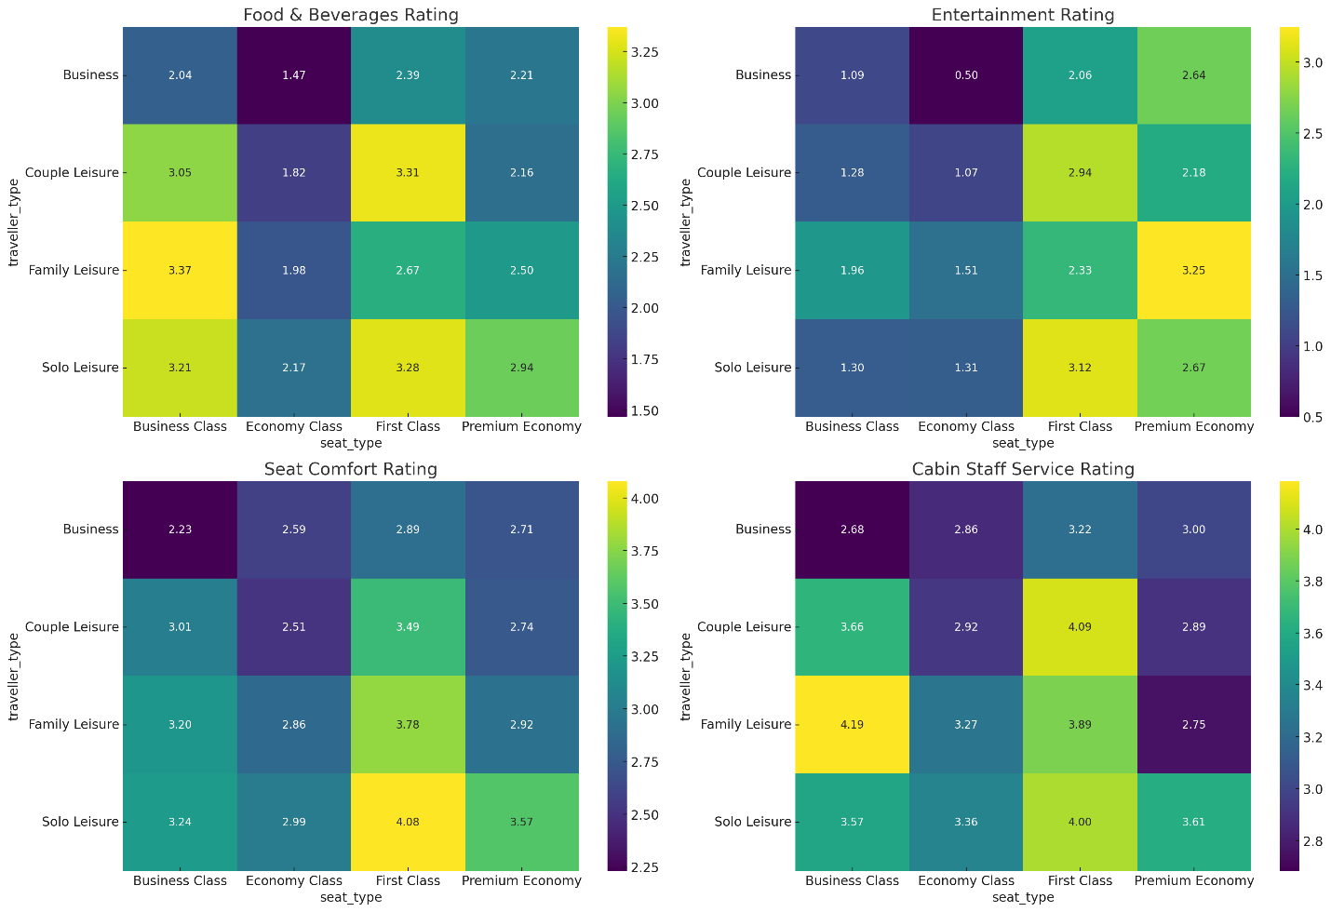
OVERALL RATINGS

Slide 19

AREAS OF IMPROVEMENT for different seat type
The heatmaps allowed me to identify areas that needed improvement as follows:
Food & Beverages:
Enhance options in Economy Class.
Differentiate offerings in Premium Economy.
Entertainment:
Upgrade Economy Class entertainment.
Update First Class content regularly.
Seat Comfort:
Address Business Class comfort issues for Business travelers.
Improve seat comfort in Premium Economy.
Cabin Staff Service:
Improve service personalization in Business Class.
Boost service levels in Premium Economy.

Slide 20
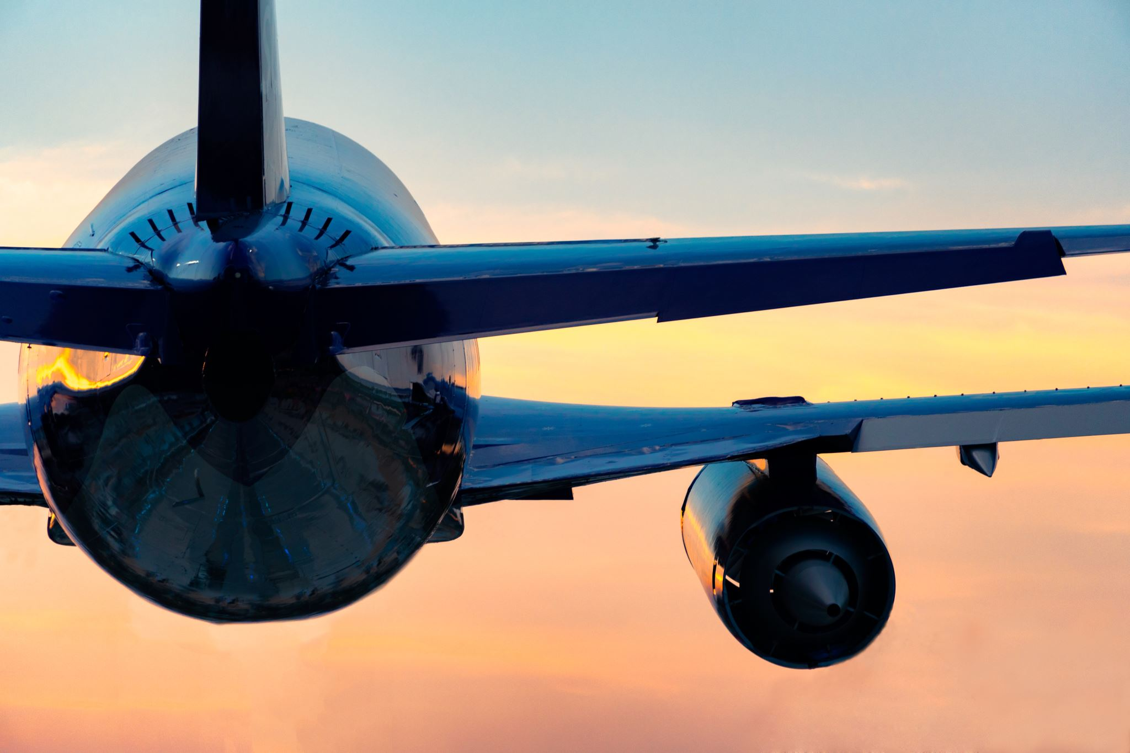
Advertising Strategies
Emphasize Quality Service
The advertising should contain positive statements on quality cabin staff and ground service accompanied by testimonials from customers that demonstrate dependability and professionalism. 2. Upgrade In-flight Entertainment
Improve areas where reviews have been most negative by offering better in-flight entertainment options and actively promoting these upgrades to enhance passenger experience. 3.Focus on Solo and Leisure Travelers
Create marketing campaigns targeting solo and couple leisure travelers with higher satisfaction, highlighting features that can improve their travel experience. 4. Enhance Family-Friendly Services
Design services for families such as special seating arrangements, kids’ meals, and entertainment to boost their satisfaction throughout their journey with British Airways. 5. Highlight Business Traveler Amenities
If applicable, market amenities or services specifically designed for business travelers such as lounge access and Wi-Fi to attract this demographic group. 6. Address Customer Concerns
Look into ways of reversing the downward trajectory of reviews through sorting out cancellation-related issues together with those of customer care in view of the Covid-19 pandemic era cases highlighted in the survey.

Slide 21
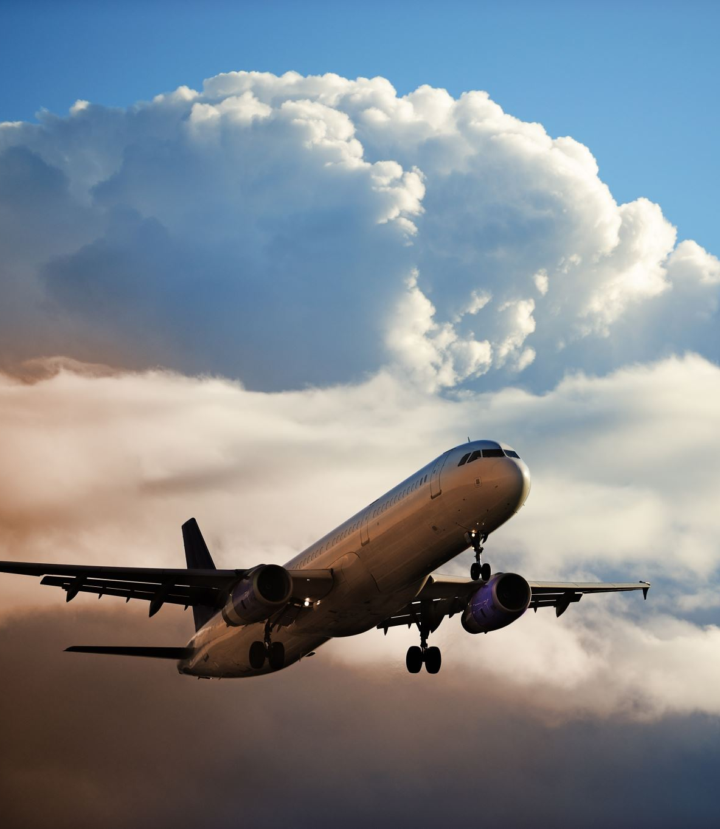
CONCLUSION
The comprehensive review from March 2016 to October 2023rovides insights into what needs to be fixed in relation to customer remarks about British airways. Best reviews revolve around cabin staff service levels as well as ground service which underscores strengths in terms of personnel interaction with customers and airport’s operational handling respectively. However, poor scores in relation to in-flight entertainment indicate there is a need to upgrade the content and technology for better passenger experience in particular on longer flights.
Demographically, solo and couple leisure travelers are the most satisfied groups, suggesting that marketing efforts should continue to target these segments. Conversely, families generally report lower satisfaction, indicating an opportunity to improve service offerings for this group possibly through tailored amenities and family-focused promotions.
While leisure travelers generally show greater satisfaction compared to business travelers, the declining trend in overall review scores since the onset of the COVID-19 pandemic suggests external factors such as flight cancellations and customer service issues have negatively impacted perceptions. This trend highlights the importance of responsive and flexible customer service policies to bolster satisfaction and loyalty.
Consequently, British Airways should use these three insights when improving its services and sales strategies that aim at meeting its diverse market needs hence increasing customer satisfaction as well reversing falling ratings

